Slide 1
People Patterns
Notes:
3 minutes intro - preamble
13 presentable slides/topics @ ~3 minutes per slide – 39minutes
3 minutes Q&A

Slide 2

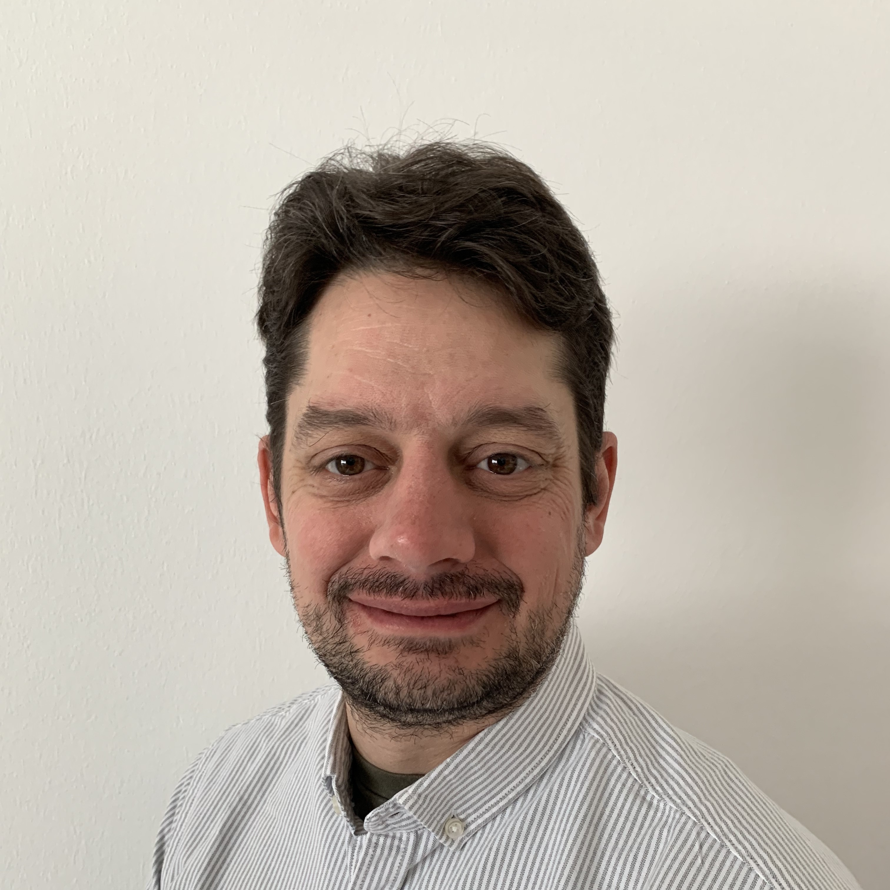

Brian Tucker
Principal Consultant
Ivar Jacobson International
Notes:
1 minute – Intro
Need a better photo; preferably wearing a jacket, possibly not as far as a tie, unless it’s a bow tie.
Hawaiian shirts and a tweed jacket are going to clash…

Slide 3
Pre-amble
No right answers; It’s a Framework
Patterns that have been observed
Explore Pro’s & Con’s of the patterns
Anti-patterns, Warning Signs
Notes:
- 2 minutes

Slide 4
Team
Notes:
We’re going to work our way up the framework. Let’s start by looking at some of the patterns that occur at the bottom.

Slide 5



An Agile Team
Product
Owner
Scrum
Master
Team
Notes:
Let’s baseline ourselves first.
An Agile team.
Small 5-9 with a preference for the smaller end of the range because it’s easier to get everyone collaborating around a piece of “work” when there’s less people.
X-Functional, the team has most of the skills necessary to complete the challenges that they are likely to be posed. There will always be a need for the team to seek outside help, be it specific business knowledge or rare technical skills, which might not be economically viable to have embedded in the team.
Self-Organising. The team are responsible for determining how the tackle the challenges that they face.
Co-located for rapid discussions about the piece of work that the team is collaborating on.
Scrum Master – To facilitate self-organisation
Product Owner – Bringing the business challenges to the team, accepting value from the team on behalf of the business
All sound familiar? So lets see what’s really happening out there in the wild.

Slide 6
Multiple Product Owners
Symptom: Multiple Products
Reaction: Multiple Product Owners
Product
Owner
Subject
Matter
Expert
Product
Owner
Subject
Matter
Expert
Product
Owner
Subject
Matter
Expert
Product
Owner
Scrum
Master
Team
Notes:
The Agile Team has to deal with multiple products
[click]
therefore it needs multiple product owners.
[click]
Subject Matter expertise should be kept separate. One individual can wear many hats, play many roles.
Product ownership is the carriage of work into the team and the acceptance of value back out.
There will be days when as a Product Owner you’re carrying work into your team that is not your area of subject matter expertise and requires the support of another expert;
Avoids teams becoming implicit component teams and encourages team stability by not reassigning product owner.

Slide 7
Proxy Product Owners
Symptom: Absent Product Owner
Reaction: Install a Proxy Product Owner
Proxy
Product
Owner
Scrum
Master
Product
Owner
Team
Notes:
Why does it occur? The official Product Owner is absent or otherwise unavailable. In order for the team to have someone to provide business direction a Proxy Product Owner is installed.
Pro’s – There’s someone with the team to answer their question
Con’s – Can be un-empowered. Increases the communication paths which will decrease the efficiency of the team because authoritative answers take longer to obtain. Increase risk to deliveries
Have to ask yourself why is the PO absent?
- Location? – PO in on timezone, team in another.
- Availability? – PO is from the business, has a business to run and doesn’t want to have to deal with the strange IT people. Fix : the PO should probably a stakeholder to the team/train and empower the Proxy PO actually be a true product owner.

Slide 8

Technical Leads
Symptom: Team
Lacks Knowledge
Reaction: Install a Technical Lead
Product
Owner
Scrum
Master
Team
Technical
Lead
Notes:
Why does it occur?
- Team don’t have the knowledge so they need someone to teach them.
Pro’s – There’s someone with the team to answer their question
Con’s – Team rely on the Tech Lead for all the solutions; to tell them what to do.
Potential Evolutions
Tech Lead should be cross-training and upskilling the team.
Facilitation trick; Tech Lead isn’t allowed to do anything! If they do it; then the team will never learn.
They’re not allowed to speak only reply to a questions. The “team” has to question the Tech Lead, in a similar manner to how they would question the Product Owner or a Subject Matter Expert, when writing the stories.
They’re not allowed to code. They can peer review and answer the q
Tread carefully, taking the coding away from these experts without explaining clearly why you’re doing it could precipitate an unwanted reaction. Try to utilise Tech-Leads that are capable of sharing information and upskilling others rather than introverted hermits and information hoarders.
Observations

Slide 9
Component Guardians
Symptom: Component
Technical Health Is
Important
Reaction: Install a Component Guardian
Product
Owner
Scrum
Master
Component
Guardian
Team
Notes:
Teams that can cut across the technology stack and get a feature delivered end-to-end are great, they’ll get value delivered quicker because they can do it without external collaborations, but there is a problem with this; who’s looking after the technical health of the components?
“Collective Code Ownership”; easy to say, but what if we need something more explicit?
The Component Guardian is responsible for the technical health of a component.
Can be a free agent within the train; or could be an expert embedded within a team.
Pro’s: Go to person for details of the component, can be used to validate changes if a high degree of control is required for submissions on a component.
Con’s: Can become a bottleneck if they’re not sharing the knowledge; the fix is to create a community of practice around the component which becomes the custodian of knowledge about that component.
Con’s: Be careful that a Component Guardian embedded in a team doesn’t make their team an implicit “component” team. Whilst the team should be encouraged to learn more about the component to ease the burden on the guardian and mitigate potential bottlenecks; any refactors or improvements to the component that are identified don’t go onto the “team” backlog but instead are sent up to the Program Backlog so that any of the teams can take them; thus spreading knowledge further.

Slide 10
Program

Slide 11



The Program Team
Stakeholders
Product Management
Release
Train
Engineer
System
Architect
Product
Owner
Scrum
Master
Team
Notes:
An overview of the current program roles.
Product Manager
System Architect
Release Train Engineer
Stakeholders – I’m referring to the more generic group of Stakeholders that are requesting work onto the train rather than the explicit Business Owners set that have authority over the train.

Slide 12
Product Owners / Product Managers
Symptom: We Have Product Owners
Reaction: Multiple Product Owners
Product Managers
Product Owners
Stakeholders
SAFe
Product
Manager
Release
Train
Engineer
Product
Manager
System
Architect
Scrum
Product
Owner
Scrum
Master
Product
Owner
Team
Notes:
Why does it occur?
- People in the business already have the job title Product Owner / Product Manager.
Observations
The carriage of work into the team and acceptance of value on behalf of the business. Are they the people that look after the backlogs? Are they available all the time to work with the team or train?
Are they in the Operational or Development Value Streams
Separation of Company Product Owners / Managers from SAFe Product Managers and Scrum Product Owners.
Company Product Owners and Managers are probably stakeholders to the train. Possibly they’re the Business Owners.
Be explicit about the naming; use the qualified phrases SAFe Product Manger and Scrum Product Owners to differentiate them from the Company roles.

Slide 13
Program Coordinator / Value Stream Owner
Symptom: Who signs the contracts?
Reaction: RTE needs help.
Stakeholders
Value Stream
Coordinator
Product Management
Release
Train
Engineer
System
Architect
Product
Owner
Scrum
Master
Team
Notes:
Why does it occur?
Somebody needs to employ the people in the VS
When we fund a VS somebody has to be responsible for the money
Observations
The RTE could do all of the above but often they’re fully engaged in the delivery process.
Sometimes the RTE is a contract resource and it would be improper for them to be signing contracts.
Often as the Line they have the ultimate accountability and the ultimate authority: Every employment contract tends to have a clause that says “You must do whatever the management say unless it’s illegal; in which case report it to HR immediately!” They should never need to enact that clause to get work done; delivery is delegated to the SAFe process and the people within it.

Slide 14
Product Management Team
Symptom: Complex Stakeholder Landscape
Reaction: More Product Managers
Stakeholders
Product Management
Release
Train
Engineer
System
Architect
Product
Owner
Scrum
Master
Team
Notes:
Not downwards scaling; more teams means more PO’s which means more support for the PM. Explain PALACE scenario.
Upwards scaling to support a complex stakeholder landscape, to maintain the relationship to that landscape and process the requests coming from that stakeholder landscape.
Anti-Patterns
Lack of accountability – no one source of truth
Lack of alignment – all equal, all with separate priorities
The anti-patterns often arise because organisations have multiple sources of “work” and they think they need separate PMs to represent that “work”. The people representing the work should really be stakeholders which means that there only need be a single Product Manager that is responsible for facilitating the flow of work.
Most Product Managers don’t own the product; they own the flow of work into their train and teams; and the deliveries back out.

Slide 15
System Architecture Team
Symptom: Complex Technical Landscape
Reaction: More Product Managers
Stakeholders
Product Management
Release
Train
Engineer
System
Architect
Product
Owner
Scrum
Master
Team
Notes:
Not downwards scaling; more teams means more Engineers which means more support for Architect; the knowledge should be embedded in the teams at point of need!
Upwards scaling; complex compliance, regulatory and/or testing landscapes that require a specialist to own specific parts of the architectural strategy, communicate the parts of the strategy.
Anti-Patterns
Lack of accountability – not invested in the train and it’s outcomes because they’re line/reporting is outside of the train.
Lack of alignment - personal goals or needs conflicting with the trains.
Dictatorship / Architectural Junta – no empowerment to the teams.
Choose your system architect wisely; they need not be the best architect in terms of technical skill but they need the facilitation skills to organise an architectural group.

Slide 16
Release Train Engineer Team
Symptom: Distributed Teams
Reaction: More Release Train Engineers
Stakeholders
Product Management
Release
Train
Engineer
System
Architect
Product
Owner
Scrum
Master
Team
Notes:
Not downwards scaling. More teams, more SMs.
Upwards (sideways!) scaling, more locations/time zones requires more support.
Deputy RTE’s in each location to act as Master-Of-Ceremonies in each location, to call the room to order.
Someone to act as the eyes and hands of the remote locations to grab tickets from the Program Backlog and build up the Program Board.
Anti-patterns
- Duplication of roles for the sake of it

Slide 17
Portfolio

Slide 18



Portfolio
Lean Portfolio
Management
Agile
PMO
Epic
Owner
Stakeholders
Enterprise
Architecture
Product Management
Release
Train
Engineer
System
Architect
Product
Owner
Scrum
Master
Team
Notes:
We see the same triad of Business, Technical and Process repeated at the Portfolio level although on the big picture it’s a little bit harder to discern.
Lean Portfolio Management – Managing the investments and ensuring that they’re getting the maximum return possible for that investment.
Enterprise Architecture – Holistic view of the technical landscape, rationalising that landscape and preparing it for future business needs.
Agile PMO – It’s not on the big picture, hence shown here in grey, but it in the framework and a very real and necessary function. There is process that need facilitating at this level and they form the head of the facilitation strand and can collate metrics to allow the Lean Portfolio Management to make sensible decisions.
Stakeholders – Any large organisation will definitely have Portfolio level stakeholders that have influence over the investment decisions even if they’re not directly responsible for the investments themselves.
Epic Owners - One particular sub-set of the Stakeholders that we’re going to be interested in are Epic Owners; people that have been tasked with shepherding the large step changes in Business Capability through their lifecycles.

Slide 19

Epic Sponsors
Symptom:
Great Idea but Too Busy to do it.
Reaction: Idea isn’t properly pursued
Epic
Sponsor
Lean Portfolio
Management
Agile
PMO
Epic
Owner
Stakeholders
Enterprise
Architecture
Product Management
Release
Train
Engineer
System
Architect
Product
Owner
Scrum
Master
Team
Notes:
Innovation can come from anywhere, but our focus here is on what happens when the people at the top have bright ideas? For those people running the business are often best placed to spot, or have, ideas about how to make the business better.
[click]
But for the people running the business; running a business is a full time job and they don’t have the spare capacity to properly own the Epic on a day to day basis.
[click]
The fix is to separate the
Pro’s
Idea has high level sponsorship to get assist with removal of impediments and blockers
Idea is more likely to be discussed and scrutinised by the Lean Portfolio management
Con’s
Epic Sponsor and Epic Owner need to be in agreement; divergence will lead to problems
Ideas without sponsorship might struggle (even if they are economically advantageous) because the sponsors naturally gravitate to their own ideas.
Authority through sponsorship can lead to dictatorship and break the economic decision making processes; i.e. reverting to Hippo prioritisation
Separation of Sponsorship from Execution

Slide 20
Epic Ownership Team
Symptom: Epics are big; sometimes bigger than just IT
Reaction: Epic ownership team
Lean Portfolio
Management
Agile
PMO
Epic
Owner
Stakeholders
Enterprise
Architecture
Product Management
Release
Train
Engineer
Business
Change
System
Architect
Building
Construction
Product
Owner
Scrum
Master
HR
Team
Notes:
Epics are step changes in Business Capability. Changing the business is often more than just the IT; rolling change out to an organisation needs specialised skills, and changing an organisation means people change.
Larger epics may need a team to properly manage the lifecycle of the Epic.
Other parts of the organisation should be empowered to run as they see fit. Other methodologies may be more appropriate for their scenarios.

Slide 21
Conclusions

Slide 22
Conclusions
Business
Content
Technical
Facilitation
Lean Portfolio
Management
Agile
PMO
Epic
Owner
Stakeholders
Enterprise
Architecture
Value Stream
Coordinator
Product Management
Release
Train
Engineer
Subject
Matter
Expert
System
Architect
Product
Owner
Scrum
Master
Users
Component
Guardian
Team
Notes:
All of this matters because you need to define Roles & Responsibilities.
Let’s give ourselves a bit more room
[Click]
Let’s add some of the extra roles previously discussed
[Click}
The responsibilities of Faciltation and Process lie here; if we’re not getting anything out of our software machine this strand needs to stop and retrospect.
[Click]
The responsibilities of Technical and Quality lie here; if we’re getting stuff out but it’s keeps crashing then this strand needs to stop and retrospect.
[Click]
The responsibilities of Content lie here; if we’re getting stuff out and it’s working fine but it’s not being used then this strand needs to stop and retrospect
[Click]
The responsibilities of running the Business lie here
It also allows you to understand who needs to meet with who.
[Click]
This is the PO Sync – Primarily for Product Management and Product owners but I always advise inviting RTE and Architect along
[Click][Click]
This is the Scrum-Of-Scrums – I always advise inviting Architect and Product Management along just in case.
[Click][Click]
User working groups for UAT testing
[Click][Click]
Epic Board for coordinating an Epic; ensuring that the right features are in the right train and the right time.

Slide 23

Questions
#SAFeSummit

Slide 24

Thank you!
Coming soon – presentation downloads at global.safesummit.com/presentations
#SAFeSummit

Slide 25
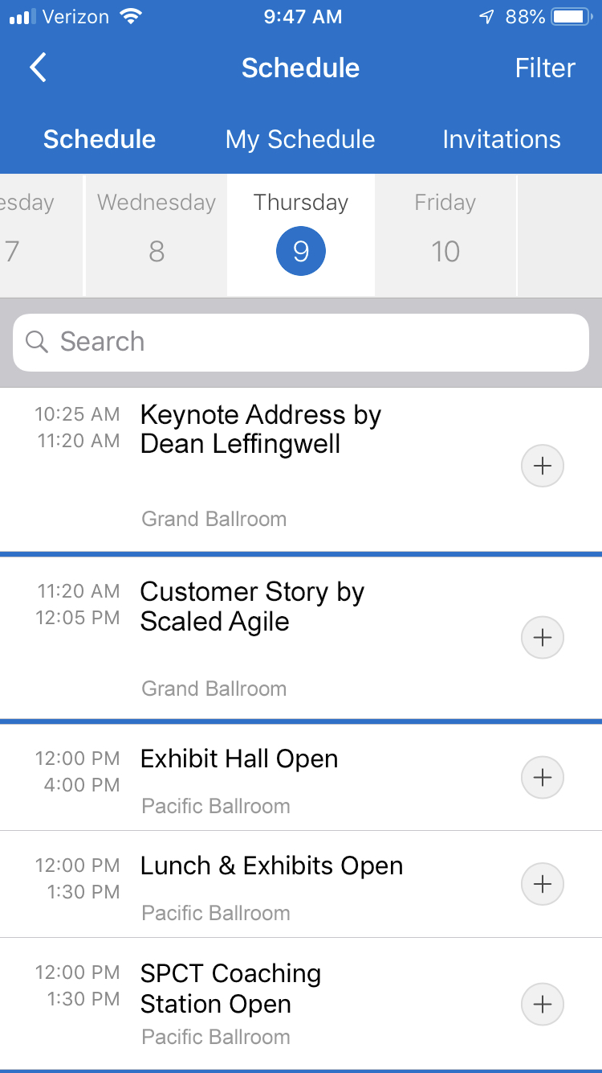
Please rate sessions
1
Click the Schedule icon in mobile app and locate the session
2
‘Check in’ by clicking the plus sign next to the session title
3
Tap star rating at top
of screen

Slide 26


System Team
Business Owners
Product Management
Product Owner or proxy (requirements analyst)
Product Owner
Team
System
Architect
System Architect or proxy
Release Train
Engineer
Scrum Master
Notes:
Scratchpad for iconography

